Slide 1
Lecture
Bells and Whistles

Slide 2
Ways to Enhance Websites
Java Script and Java
Sound and Video
Flash
XML (Extended Markup Language
Database Connectivity
Ecommerce
Ajax – (asynchronous JavaScript and XML),

Slide 3
What is Java Script?
Text-based Programming Language
Used to Enhance Websites
  Interactivity
  Animation
  Dynamic Content
  Games
  Calculations
All “code” is run by the browser

Slide 4
What is Java?
Java is also a language (OOP - Object Oriented Programming Language)
Used to create “applets”
  Little programs that sit on a web server
  Called by the webpage
  Code cannot be “stolen” – It’s compiled
HTML only references the applet

Slide 5
Java vs Java Script
Java
  Called by HTML from the server
  Hidden Code
  Quicker Execution
Java Script
  Stored in HTML (inline or internal)
  Viewable Code
  Slower Execution

Slide 6
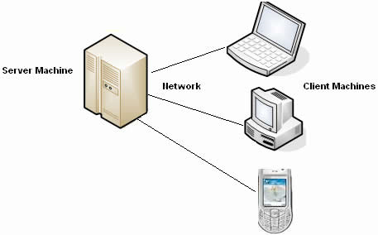
Java vs Java Script
Java Script
Java Programs
Java Script
Java Script

Slide 7
Java Script Syntax
Tells the browser we are starting some JavaScript code to run.
Internal Script:
<script language="JavaScript">
<!--
alert("Hello World!");
//-->
</script>
Programming steps to actually execute.
Finishes the block of code.

Slide 8
Java Script Syntax
Inline Script:
<a href="index.html"
onMouseOver="document.logo.src='Images/halloween.png'“
onMouseOut="document.logo.src='Images/logo.jpg'">
<img src="Images/logo.jpg" name="logo" border=0 alt="A Splash Of Sugar">
Event Trigger
Action to Take
Parameter

Slide 9
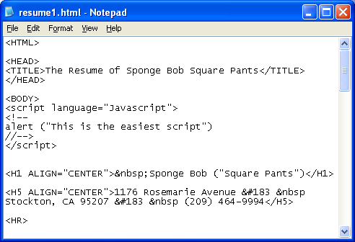
Java Script Syntax (cont)

Slide 10
Java Script Examples
Alert Message
Functions and Buttons
Mouse-Over Image Swap
Today’s Date

Slide 11
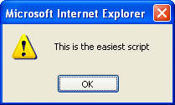
Example 1 – Alert Message
<script language="Javascript">
<!--
alert ("This is the easiest script")
//-->
</script>

Slide 12
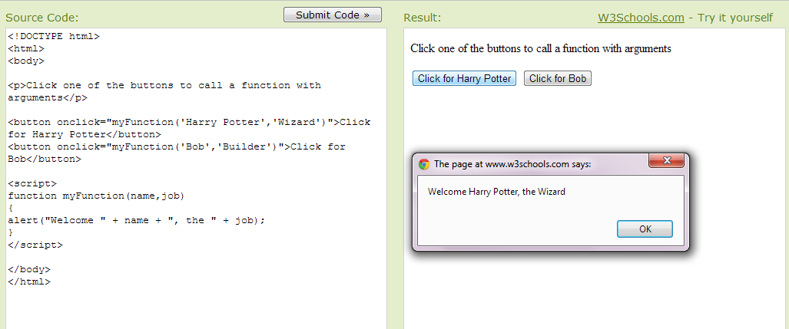

Example 2 – Functions & Buttons

Slide 13
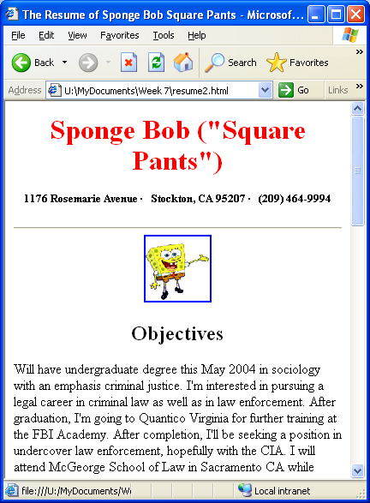
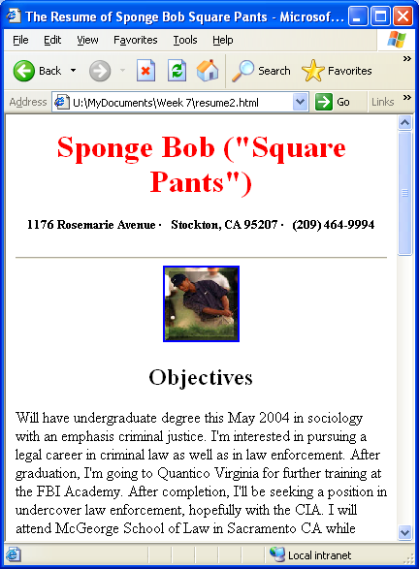
Example 3 – Mouse Over
<a href="index.html" onMouseOver="document.logo.src='Images/sponge_bob.png'" onMouseOut="document.logo.src='Images/logo.jpg'"> <img src="Images/logo.jpg" name="logo" border=0 alt=“Logo">

Slide 14
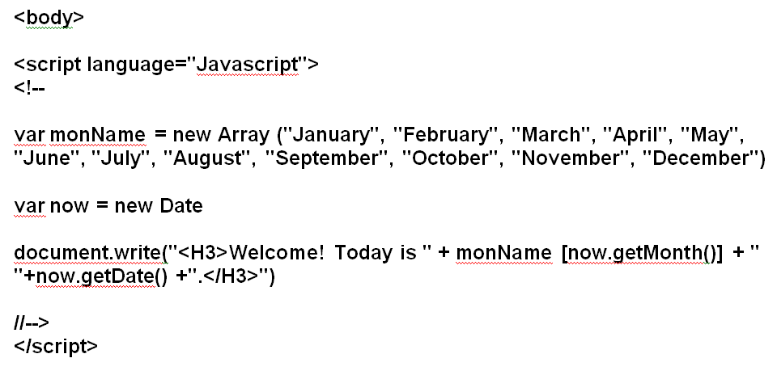

Example 4 – Today’s Date

Slide 15
More Java Scripts
Dynamic Drive
  www.dynamicdrive.com

Slide 16
Adding Sound
As a Link:
  <a href="moo.wav“>Click here for the cow</a>
Automatically Loading:
  <embed src=“moo.wav”>
  Variables:
  hidden=“true” to hide player
  loop=“1” or “-1” how many times does it play?

Slide 17
Finding sound files
Google
Find song and YouTube and convert to .mp3 file
  Click Share
  Copy URL
  Go to:
www.youtube-mp3.org
Then……….

Slide 18
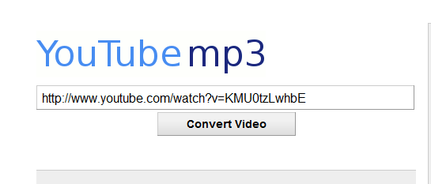
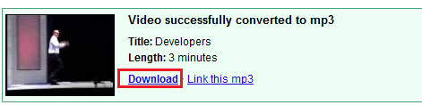
YouTube to.mp3
Paste link into YouTube to .mp3
Click: Convert Video
Then Download to
web-docs
Save according to
file-naming
conventions:
short, no spaces!

Slide 19
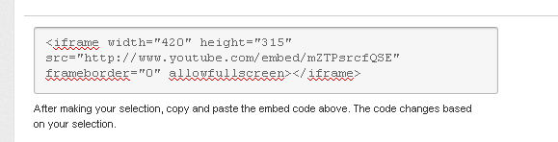
Adding Video
Google YouTube
Click Embed
Copy and paste the <iframe> tag where you want the video

